Slide 1
Capstone Project - Microfinance Loans
-Arnav Sharma
-Meera Krishnakumar

Slide 2
Background Description
Loan Product X
The Bank
Weekly Income Data
Repayment
Yes/No, Loan Amount
Loan
Dairy Farmer
Payment
Food Company
Payment
Dairy Farmer
Milk
Milk
Test Data
Training Data

Slide 3
Problem Statement
Develop Product X
To identify the farmers who can be given the loan.
To suggest the amount of loan which can be given.

Slide 4
Model Building (1/2)
Input
52-week income data of 1275 farmers.
Output
Farmer Clusters (Eligible and Non-Eligible) and loan amount for individual Eligible Farmer.
Assumptions
All farmers with less than 13 payments out of 52 weeks have been eliminated.
We have considered all missing values as 0, i.e., the farmer has not sold the milk to the food company in that week.

Slide 5
Model Building (2/2)
Based on our research, all banks consider a Credit Score to decide whether the customer can be given a loan or not
We have considered Credit Score to be related to
Income History (Average income) of the farmer
Regularity of payments to the Bank
We have considered moving average of the weekly income with a 13-week window to calculate the average income for each farmer
Our second parameter is a average of number of defaults with a 13-week window for each farmer - this helps in determining regularity of payments

Slide 6
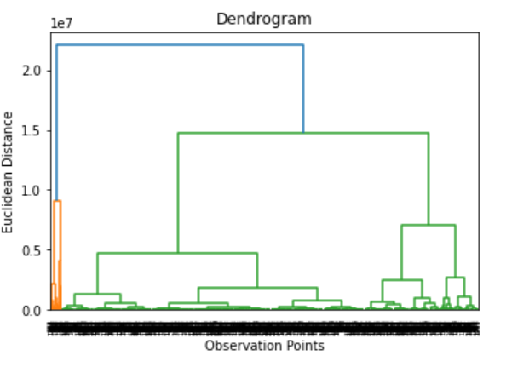
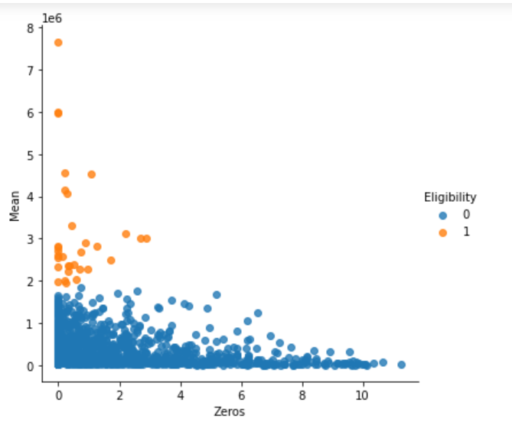
Model Building- Hierarchical Clustering with 2 clusters
Category 0 : Eligible ; Category 1 : Not eligible

Slide 7
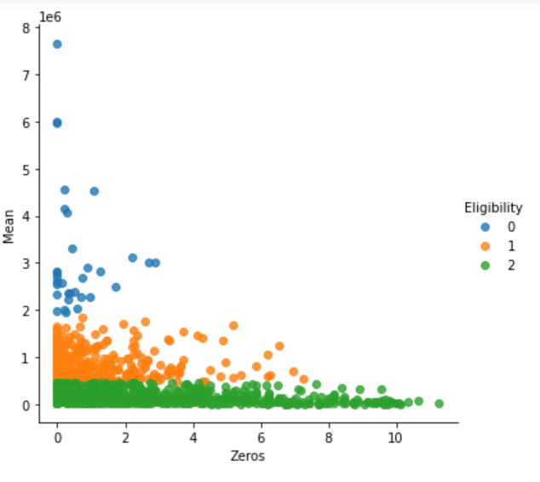
Model Building- Hierarchical Clustering with 3 clusters
Category 0 : Eligible ; Category 1 : May be eligible ; Category 2 : Not eligible

Slide 8
Model Building
To get the optimum number of farmers who can be given the loan, we calculated the following:
95th percentile of moving average of income
90th percentile of moving average of income
75th percentile of moving average of income
25th percentile of moving average of defaults
We altered the eligibility to get the best possible number of farmers who can be given the loan.

Slide 9
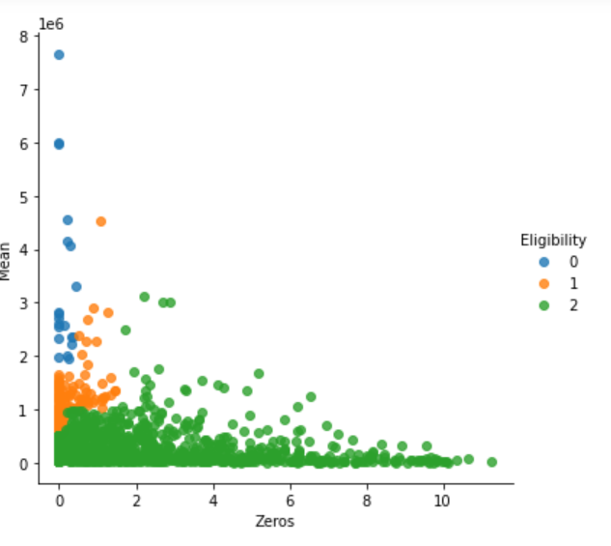
Model Building- Final Clusters
Category 0 : Eligible ; Category 1 : May be eligible ; Category 2 : Not eligible

Slide 10
Model Building
For finding the loan amount, we are considering rate of interests
20% for Cluster 0
25% for Cluster 1
Cluster 2 is considered to be not eligible for the loan, therefore the loan amount is 0
We are also assuming that the RBI guidelines will be followed i.e sum of monthly loan repayment and monthly interest payment cannot exceed 50% of monthly income
https://www.business-standard.com/article/finance/rbi-proposes-to-lift-interest-rate-cap-on-microfinance-institutions-121061500044_1.html

Slide 11
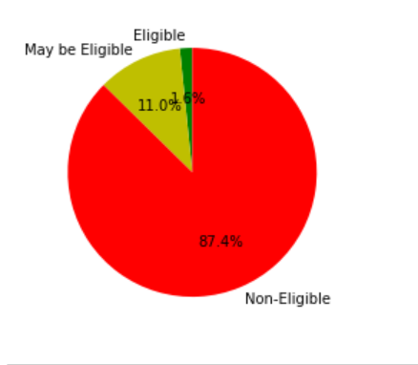
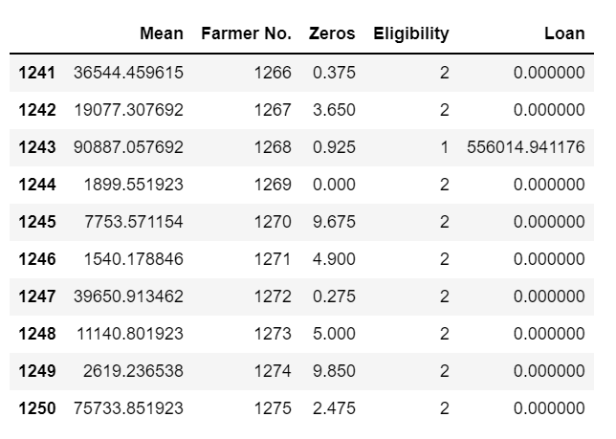
Results
Category 0 : Eligible ; Category 1 : May be eligible ; Category 2 : Not eligible
Category 0: 20; Category 1: 138; Category 2: 1093

Slide 12
Thank You!

